Slide 1

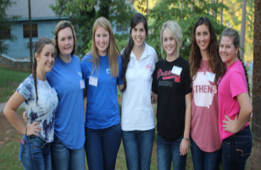
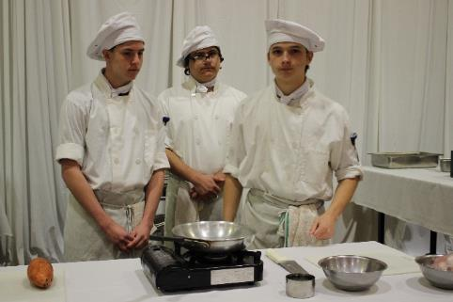

Family, Career and
Community Leaders
of America
Logos Courtesy of www.fcclainc.org

Slide 2
Mission
Mission Statement:
To promote personal growth and leadership development through Family and Consumer Sciences Education. Focusing on the multiple roles of family member, wage earner, and community leader, members develop skills for life through:
character development
creative and critical thinking
interpersonal communication
practical knowledge
career preparation.
I’m in FCCLA, But I’m Not Video:
https://www.youtube.com/watch?v=KWvTFCdFFX4
Central focus is the Family and Family Life

Slide 3
Creed
Creed:
We are the Family, Career and Community Leaders of America.
We face the future with warm courage and high hope.
For we have the clear consciousness of old and precious values.
For we are the builders of homes.
Homes for America’s future.
Homes where living will be the expression of everything that is good and fair.
Homes where truth, and love, and security and faith will be realities, not dreams.
We are the Family, Career and Community Leaders of America.
We face the future with warm courage and high hope.

Slide 4
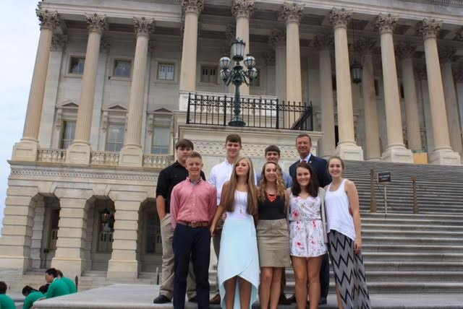
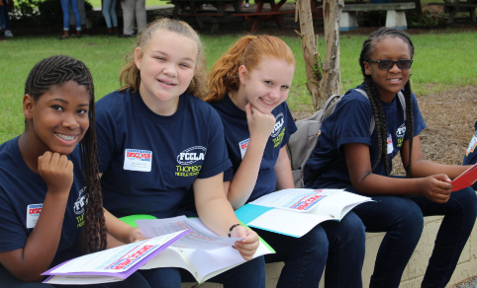
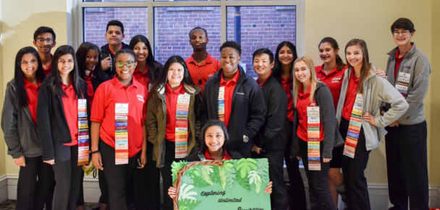
Benefits of Joining a Student Organization
Leadership Development
Personal Growth
Community Service
Scholarship and College Opportunities
Travel Opportunities

Slide 5








Career, Technical Student
Organizations (CTSOs)
Family, Career and Community Leaders of America (FCCLA)
Future Business Leaders of America (FBLA)
DECA: An Association for Marketing Students
Career and Technical Instruction (CTI)
Technology Student Association (TSA)
SkillsUSA
FIRST Robotics
National FFA Organization

Slide 6
FCCLA History
Future Homemakers of America
(FHA)
Founded in June 11, 1945 in Chicago
Co-sponsored by:
  American Home Economics Association
  & US Department Of Education
  History of FCCLA Video: https://www.youtube.com/watch?v=4sKp8V6W6Ks

Slide 7
FCCLA FACTS
Colors: Red is symbol for strength
White is symbol for sincerity
Flower: Red Rose
Motto: “Toward New Horizons”
Notes:
Red rose – represents the organization b/c it gives joy through its beauty and fragrance. It symbolizes a desire for beauty in everyday living.

Slide 8

FCCLA Facts
Original 1945 Emblem
  Octagon – Represents
  the 8 FCCLA Purposes
  Hands in the middle supporting a home
  Rays extending out represents members reaching out into the community

Slide 9
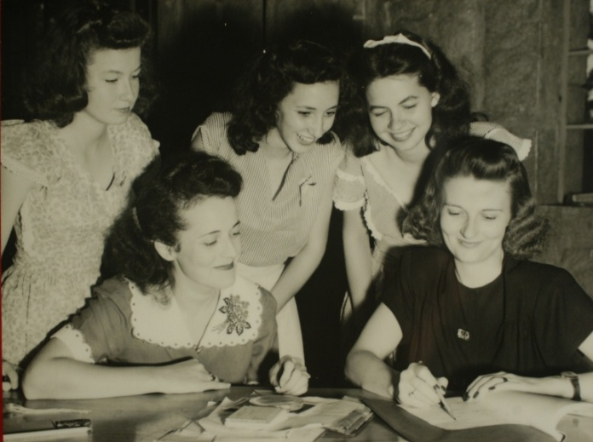
FHA History
Future Homemakers of America
Georgia second state to affiliate
Georgia first to have
full-time state adviser,
Mrs. Janette McGarity-Barber
Georgia’s first state President was Pat Randolph
She was also Georgia’s first National Officer
Randolph Cabin in honor of her at the Georgia FFA-FCCLA Center in Covington

Slide 10
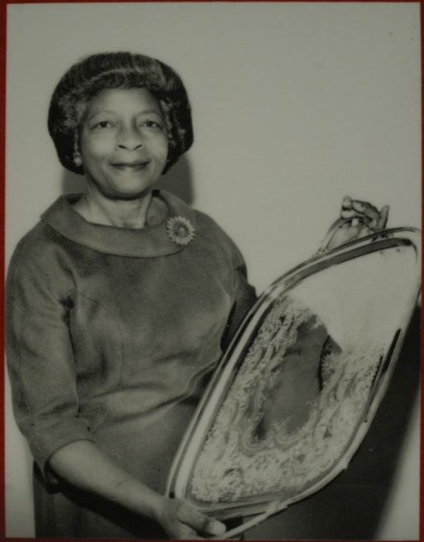
Georgia NHA History
New Homemakers of America
  Organization in the African American schools
  First GA State Adviser, Miss Daisy Lewis
  Cabin named in her honor
  at Camp John Hope in Fort Valley
  1965 – NHA and FHA
  merged

Slide 11

FHA Changes to FCCLA
1983: National Headquarters Opened in
Reston, Virginia
1995: Home Economics Became
Family and Consumer Sciences
1999: Name changed from FHA to FCCLA
1999: New Emblem Introduced

Slide 12


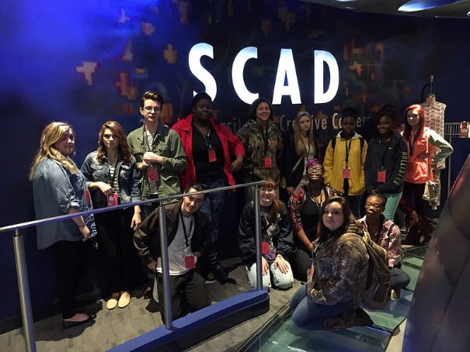
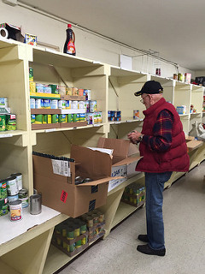
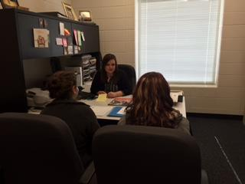
National Programs
National Awards –Apply Online by March 1
1st Place High School $1,000
1st Place Middle School $1,000
Runner up $500

Slide 13


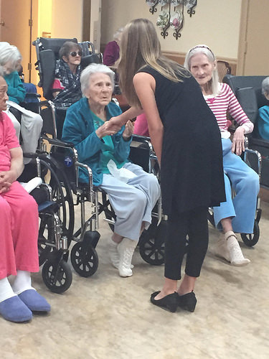

National Programs

Slide 14



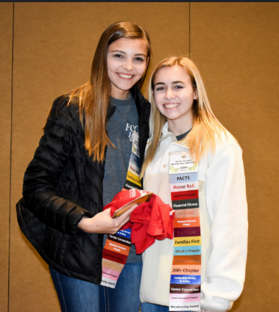
National Programs

Slide 15
National FCCLA
National Website - www.fcclainc.org
10 National Officers
Plan National Conferences:
National Fall Conference in November
National Leadership Conference in July
Georgia had national officers last year (2018-2019)
  Avery Hurst, Coffee High School – National 1st Vice President
  Julia Peake, Flowery Branch High School – National Vice President of Finance

Slide 16
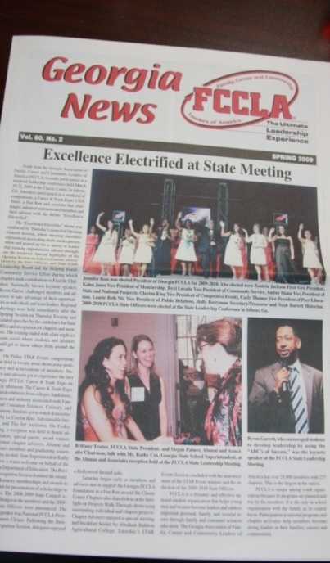

Publications
Georgia News:
The State Newspaper
Each chapter receives a copy of Georgia News twice a year and it is also available online
Teen Times:
The National Magazine
Each chapter receives a classroom set 3 times a year

Slide 17
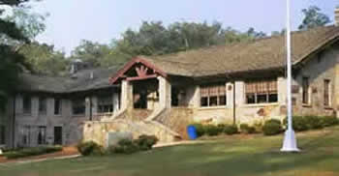
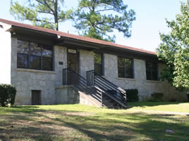
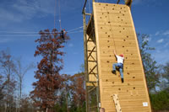
Georgia FCCLA
Two Camps:
1. Georgia FFA-FCCLA Center in Covington
Summer Leadership Camp in May – June
BASIC Training
2. Camp John Hope in Fort Valley
GOLD Training

Slide 18
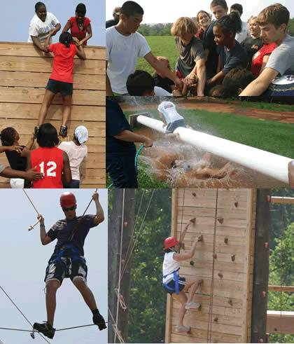
BASIC Training
Building and Achieving Success in Chapters
Chapter Planning
Team Building
Leadership Obstacle Course
Low and High Ropes
Helps to…
Increase chapter involvement
Develop unity
Build trust
Improve communication
Develop confidence and leadership skills

Slide 19
Georgia FCCLA
Executive Director – Traci Bryant
Board of Directors Chair – Beth Pilkington
State STAR Events Coordinator – Karla Buckholz
  Georgia FCCLA State Office
  P.O. Box 840
  Bogart, GA 30622
  770-530-1874
  gafccla@gmail.com

Slide 20
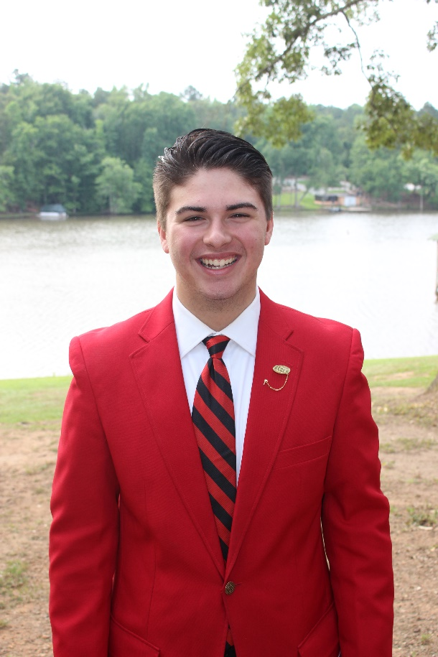
Georgia FCCLA
State President
Matt Penrow
Lincoln County
High School

Slide 21
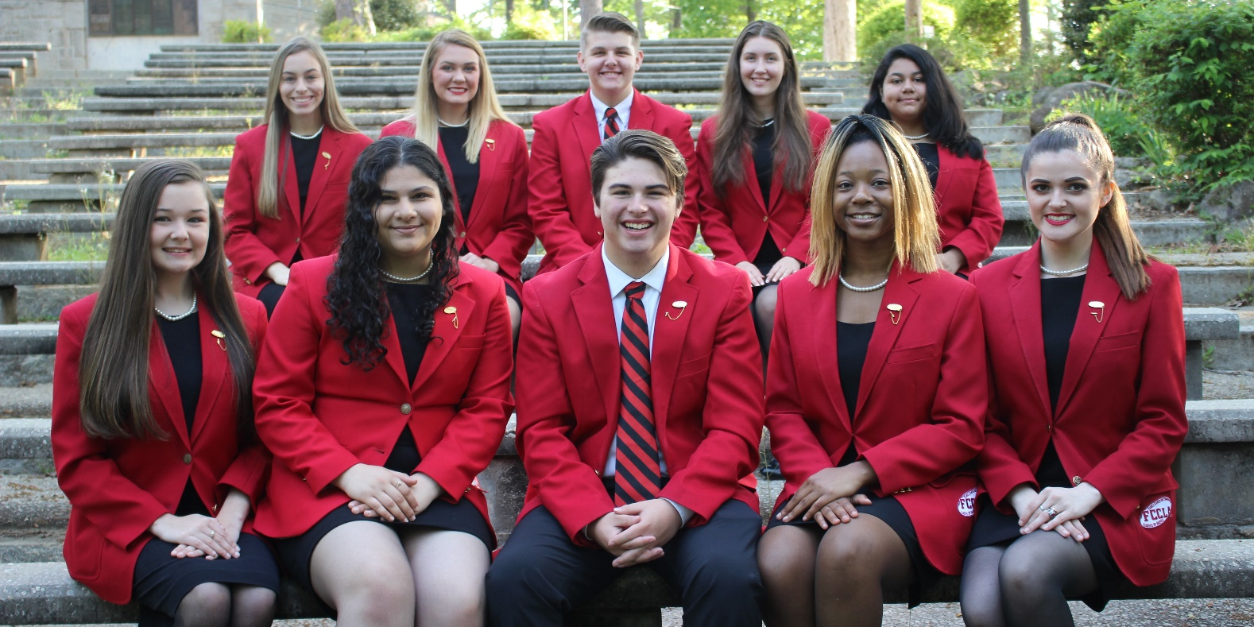
Georgia FCCLA
2019-2020
State Officers

Slide 22
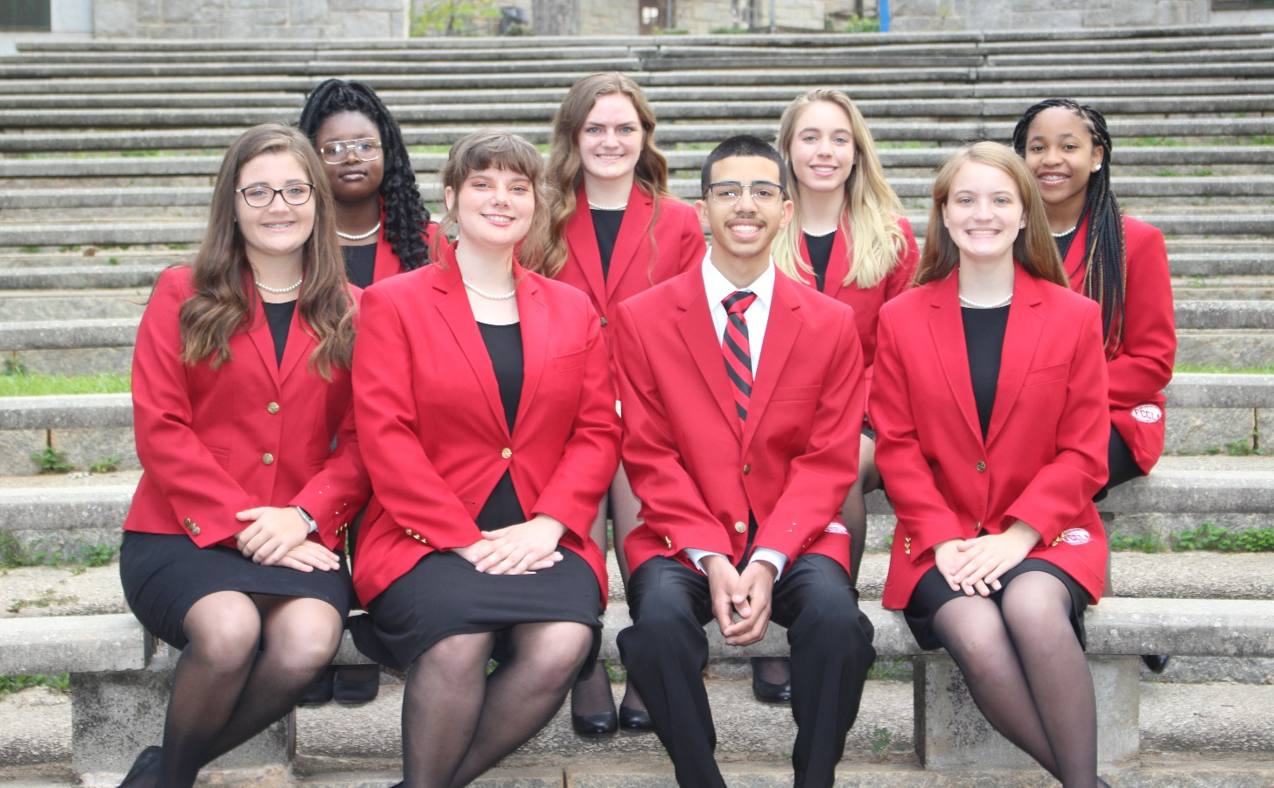
Georgia FCCLA
2019-2020
Region Officers

Slide 23

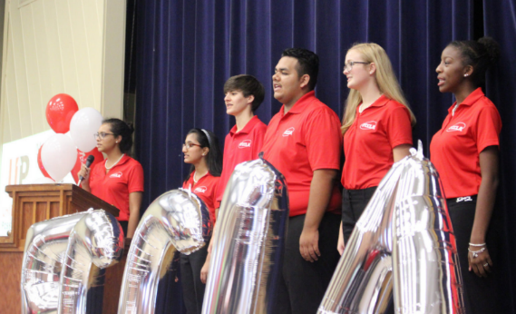
DISCOVER Training
(Developing Individual School Chapter Officers with
Vision, Energy and Responsibilities)
September 14, 2019
Camp John Hope
Fort Valley, GA
Develop your chapter officers with this dynamic training led by the Georgia State Executive Council!

Slide 24
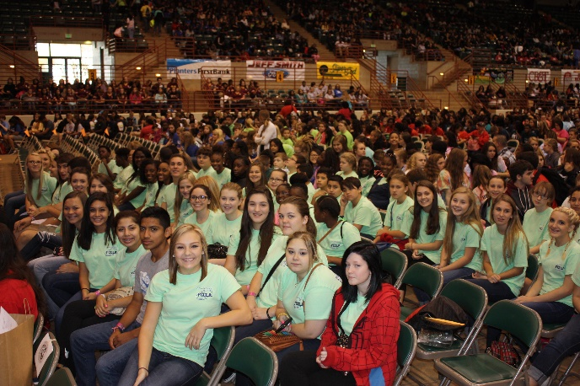
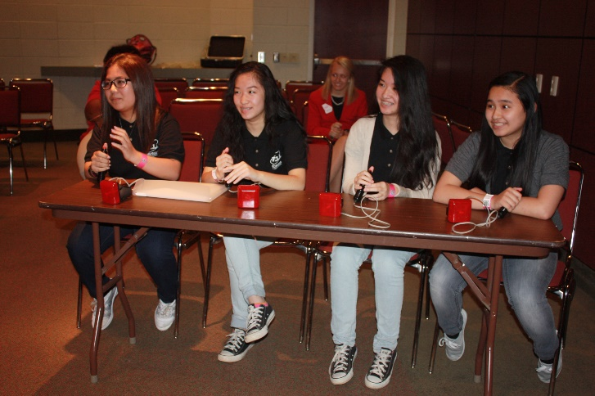
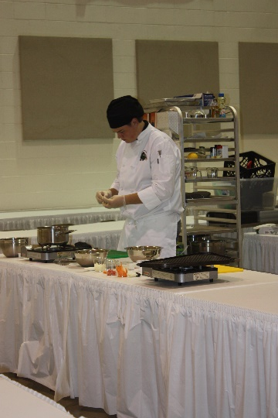
Fall Leadership Rally
October 9, 2019
  Georgia National Fairgrounds
  Perry, Georgia
Includes:
Wednesday’s Fall Motivational Rally
Culinary Competition
Tuesday’s Chili Cook-Off
Knowledge Bowl
Brochure Event
Chapter Booth Event
Food Demonstrations
Fair Rides and much more!

Slide 25
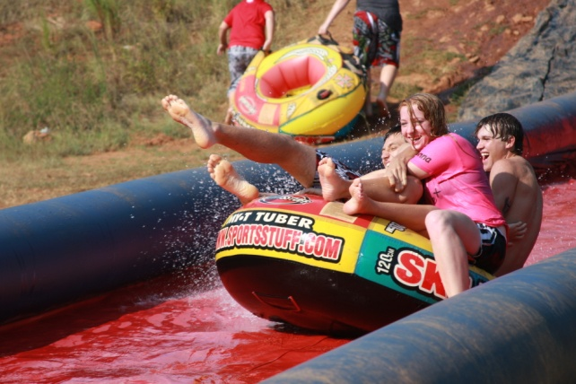
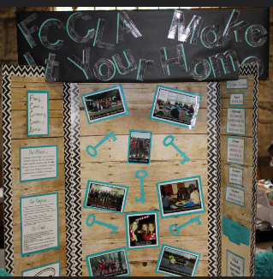
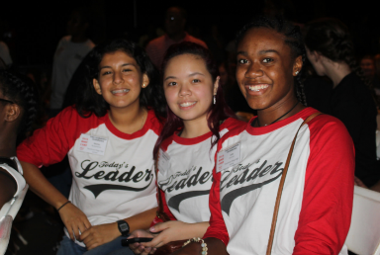
Fall Leadership
Conference
November 5-6, 2019
  Georgia FFA-FCCLA Center, Covington, GA
  OR
  November 6-7, 2019
  Camp John Hope, Fort Valley, GA
Includes:
Keynote Speaker
Leadership Breakout Sessions
Chapter Planning Time
Mini BASIC Training
Foundation Dance
Membership Recruitment
T-shirt Design Competition
State Lapel Pin Competition
Slip ‘n Slide, Putt Putt and More!

Slide 26
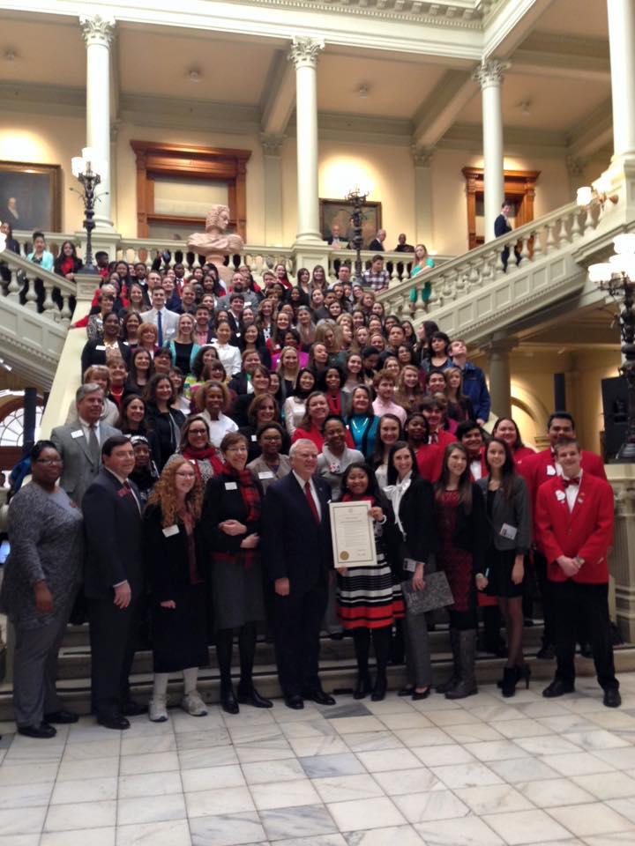
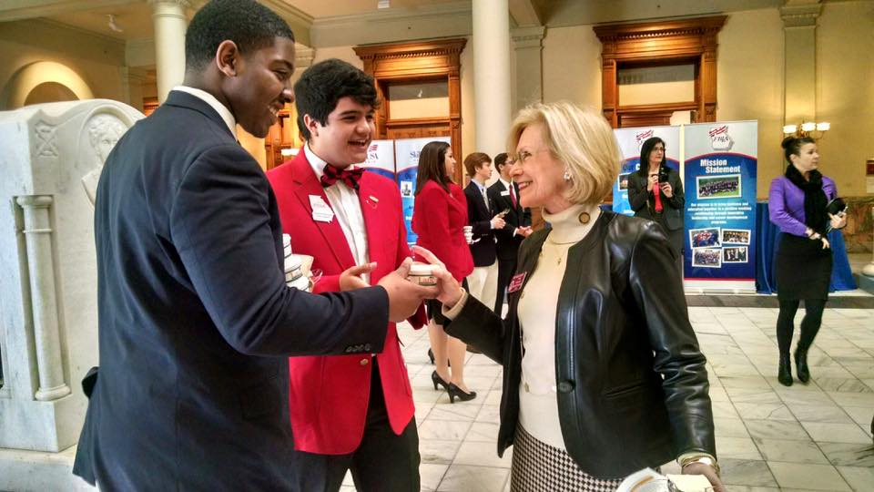
FCCLA Day at the Capitol
February 10-13, 2020
Georgia State Capitol
Visit Local Legislators
Capitol Scavenger Hunt
Region Photos

Slide 27

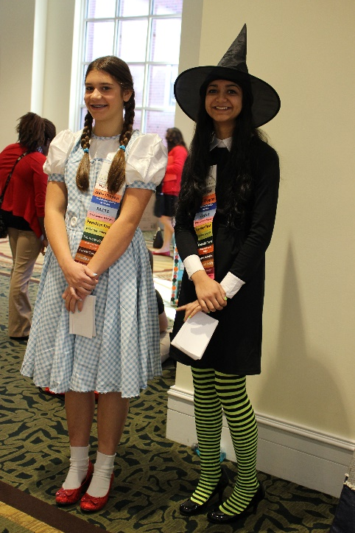
STAR Events Competition
Region STAR Events Competition
February 7, 2020 (Region 5)
February 15, 2020 (Regions 1 & 9)
February 22, 2020 (Regions 2, 3, 4, 6, 7, 8)
TOP TWO move to state competition at the State Leadership Conference

Slide 28
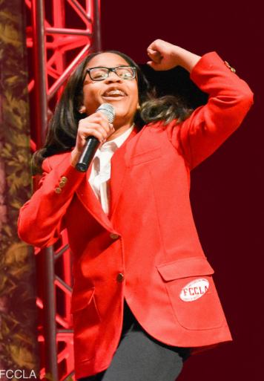
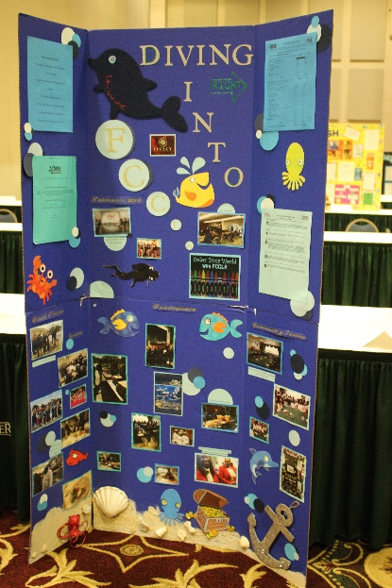
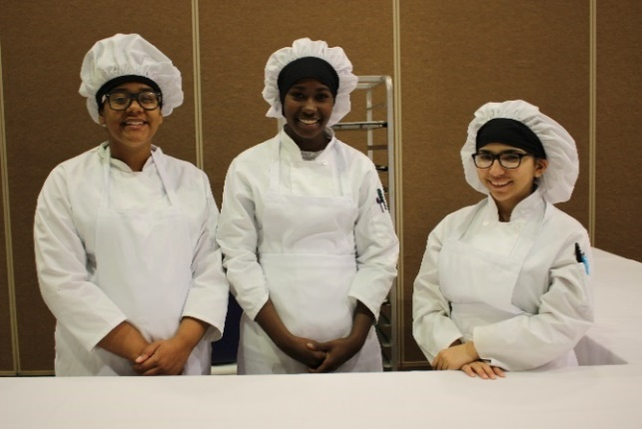
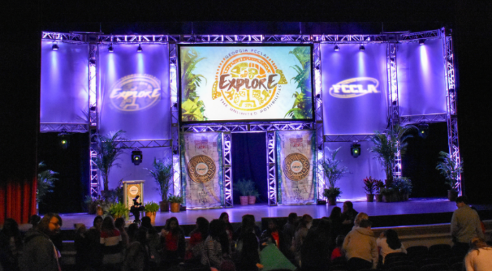
State Leadership Conference
March 20-22, 2020
Atlanta, Georgia
Includes:
Keynote Speaker
State Competitions
Foundation Event
State Officer Elections
Honor Roll Awards
Membership Awards
Chapter of the Year

Slide 29


National Meetings
Capitol Leadership
September 30-October 2, 2019
Washington, DC
National Fall Conference
November 15-17, 2019
Dallas, Texas
National Leadership Conference
July 5-9, 2020
Washington, DC

Slide 30




For More Information:
Websites:
www.fcclainc.org
www.gafccla.com

Slide 31


